Slide 1
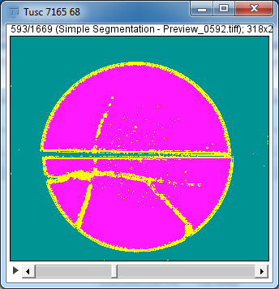
To work total % volumes
Open segmented tiff stack (the one that also segmented out the background) in FIJI
Image→Lookup tables (I usually use glasbey on dark as it shows up well)
This example has three segmented
types: fractures, matrix and outside

Slide 2
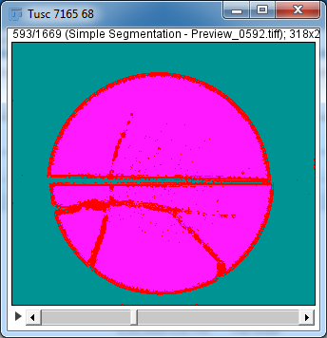
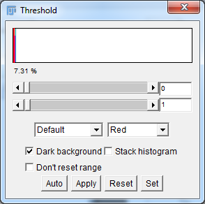
To work total % volumes
Image→Adjust-->Threshold
Moving the threshold bars around you should be able to figure out the order (from left to right) the parts that are seg.
Fractures in dark red

Slide 3
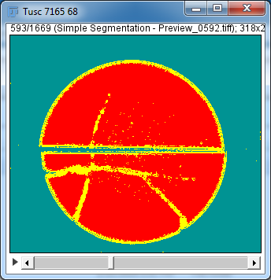
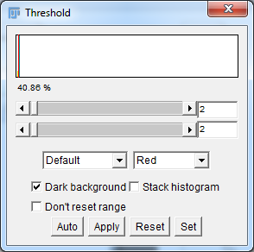
2
Matrix in dark red

Slide 4
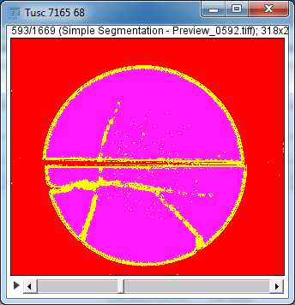
3
Background in dark red

Slide 5
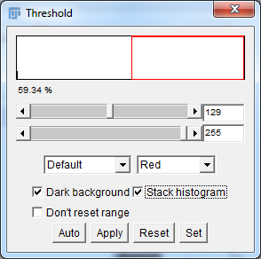
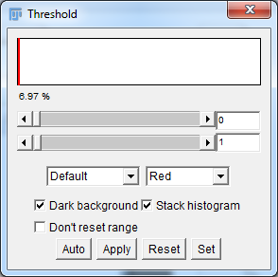
Then check off Stack histogram so you are looking at the entire stack and not just one slice
Give it a minute or two to process
Scroll both bars over to the left
% given in same order we previously worked out, here fractures are 6.97% volume pre-correction

Slide 6
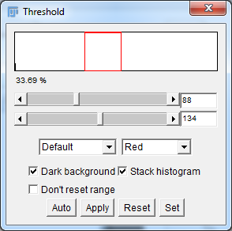
Move slider bars to get 2nd %, make sure to move both slider bars or it will sum the previous seg. in
2nd one →matrix is 33.69%

Slide 7
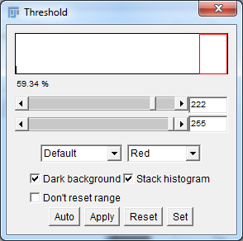
Last one for this set is background, 59.34%

Slide 8
Now you need to recalculate based on removing the background so you get a realistic answer for the rock.
6.97+33.69+ 59.34=100 (I always check since I’m paranoid)
100-59.34=40.6
6.97/40.6=17.2% fractures by volume
33.69/40.6=82.99% matrix by volume

